Slide 1
Software Processes
Based on Slides from Prof. Christopher Parnin

Slide 2
Software Process
Process by which user needs are translated into a software product.
The process involves
translating user needs into software requirements,
transforming the software requirements into design,
implementing the design in code,
testing the code, and
sometimes installing and checking out the software for operational use.

Slide 3
Traditional Software Process Models
Plan-driven models
Up front requirements
Stable requirements
Cost of development minimized by up front planning
Architecture and design documented and inspected
“Do it right the first time”
Safety- and mission-critical systems

Slide 4
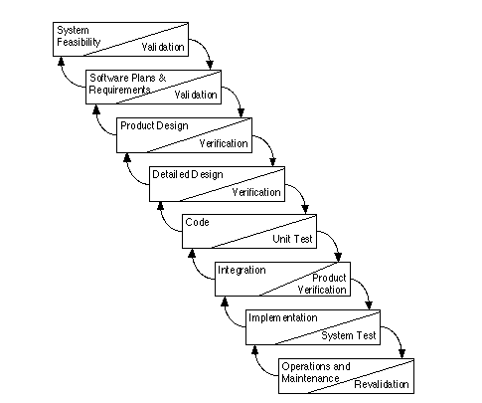
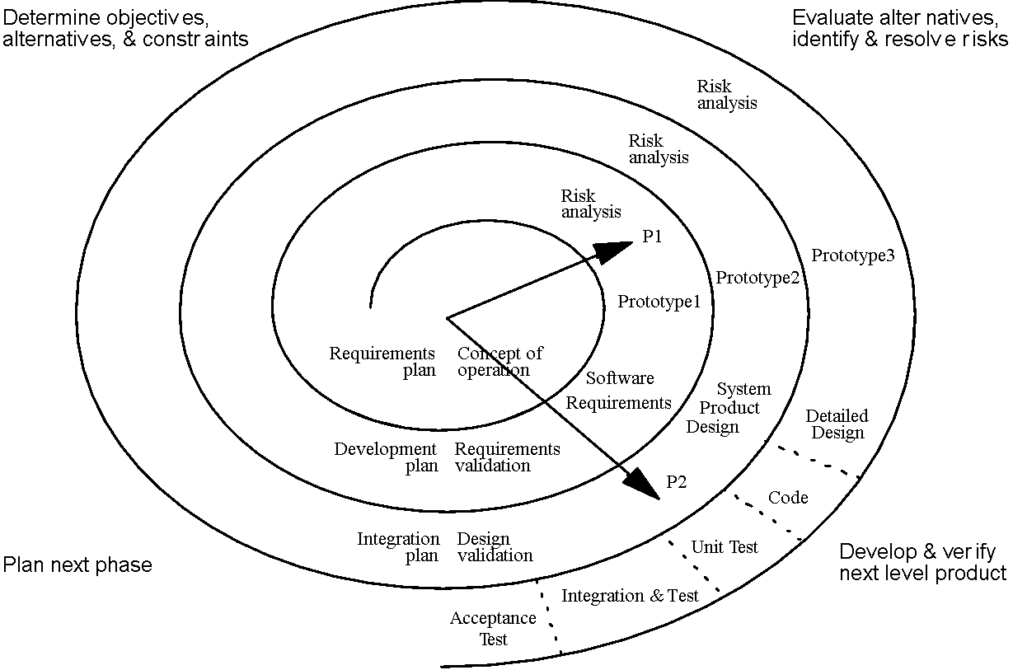
Spiral Model
Waterfall Model

Slide 5
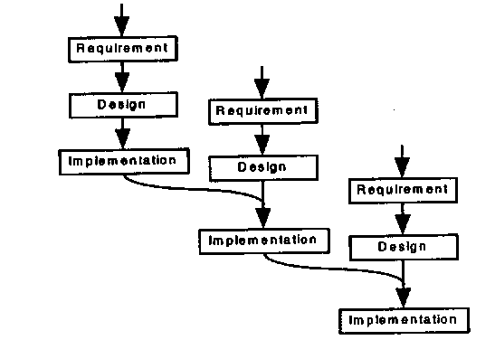
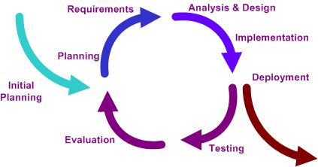
Iterative Model
Incremental Model
Iterative Model

Slide 6
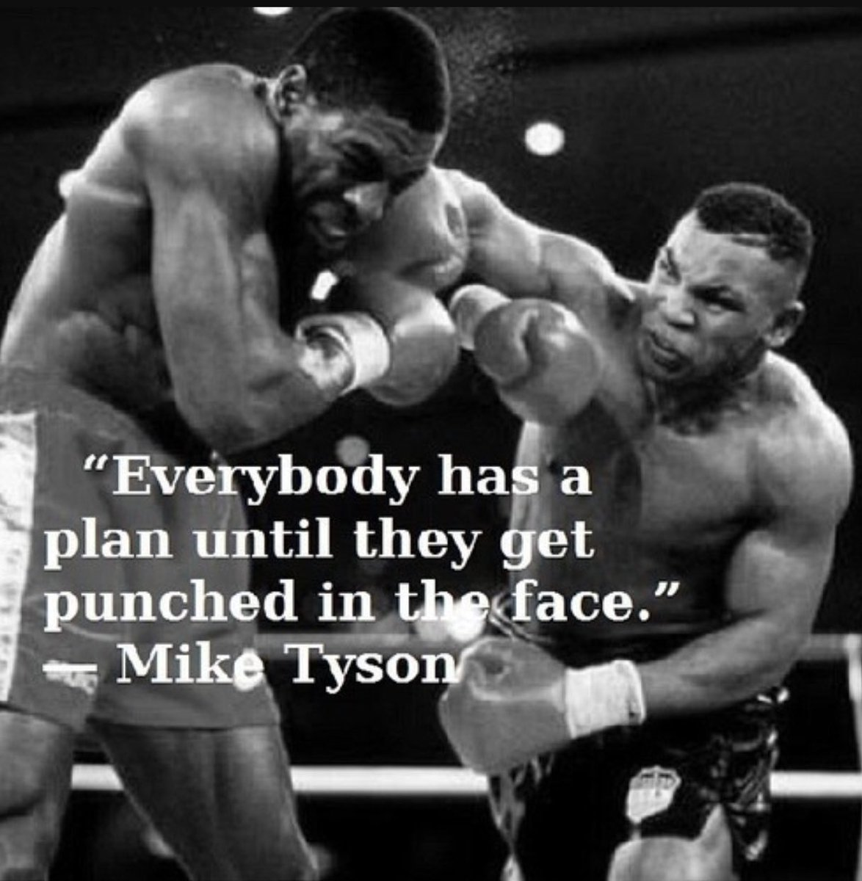

Slide 7
The Roots of Agile
Reaction to waterfall as the traditional software process.
Bound together with the “Agile Manifesto”:
We are uncovering better ways of developing software by doing it and helping others do it. Through this work we have come to value:
Individuals and interactions over processes and tools
Working software over comprehensive documentation
Customer collaboration over contract negotiation
Responding to change over following a plan
That is, while there is value in the items on the right, we value the items on the left more.
http://agilemanifesto.org/

Slide 8
Agile at a High Level
“Agile” represents a collection of software development practices:
Extreme Programming
Scrum
Feature Driven Development
Crystal Methods
etc...

Slide 9
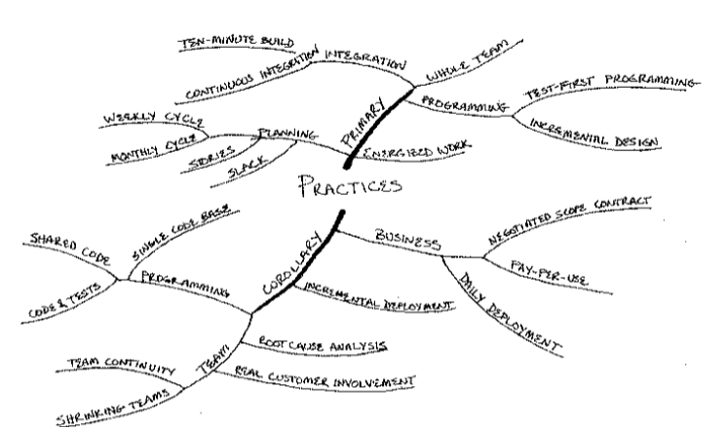

Extreme Programming (XP)

Slide 10
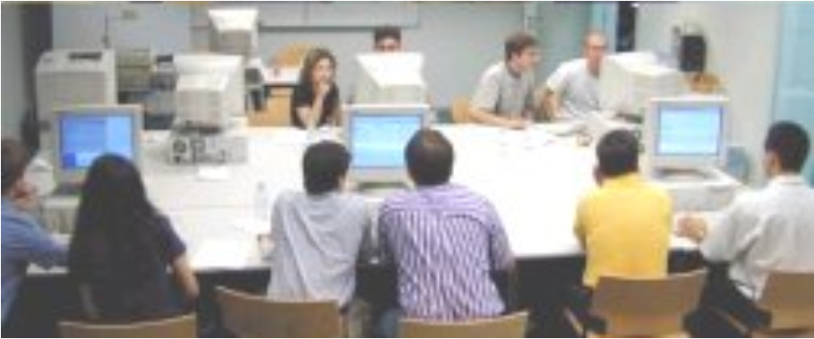
Sit Together
Develop in an open space big enough for everyone.
Have small, private spaces nearby.

Slide 11
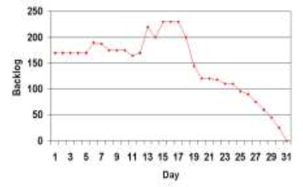
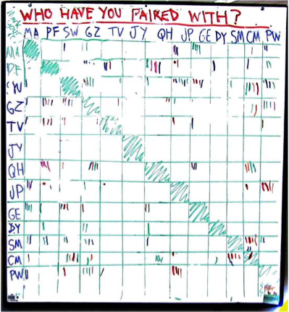
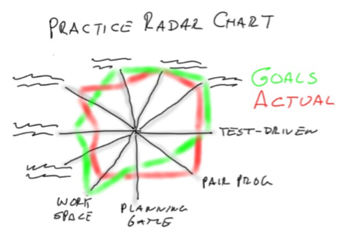
Informative Workspace

Slide 12
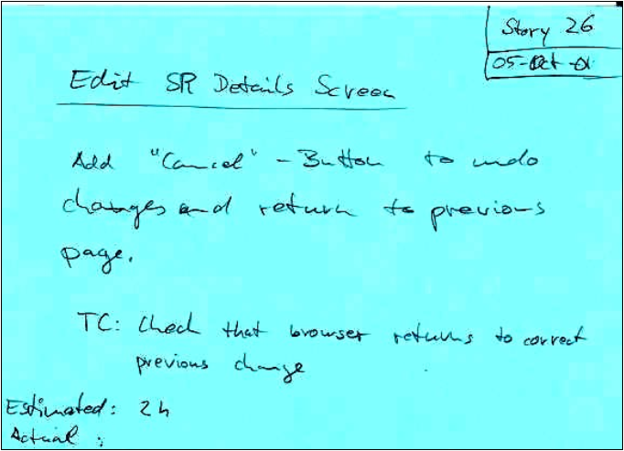
Stories
Customer-visible functionality Not “requirements”
Estimates made early Not tasks
© Laurie Williams

Slide 13
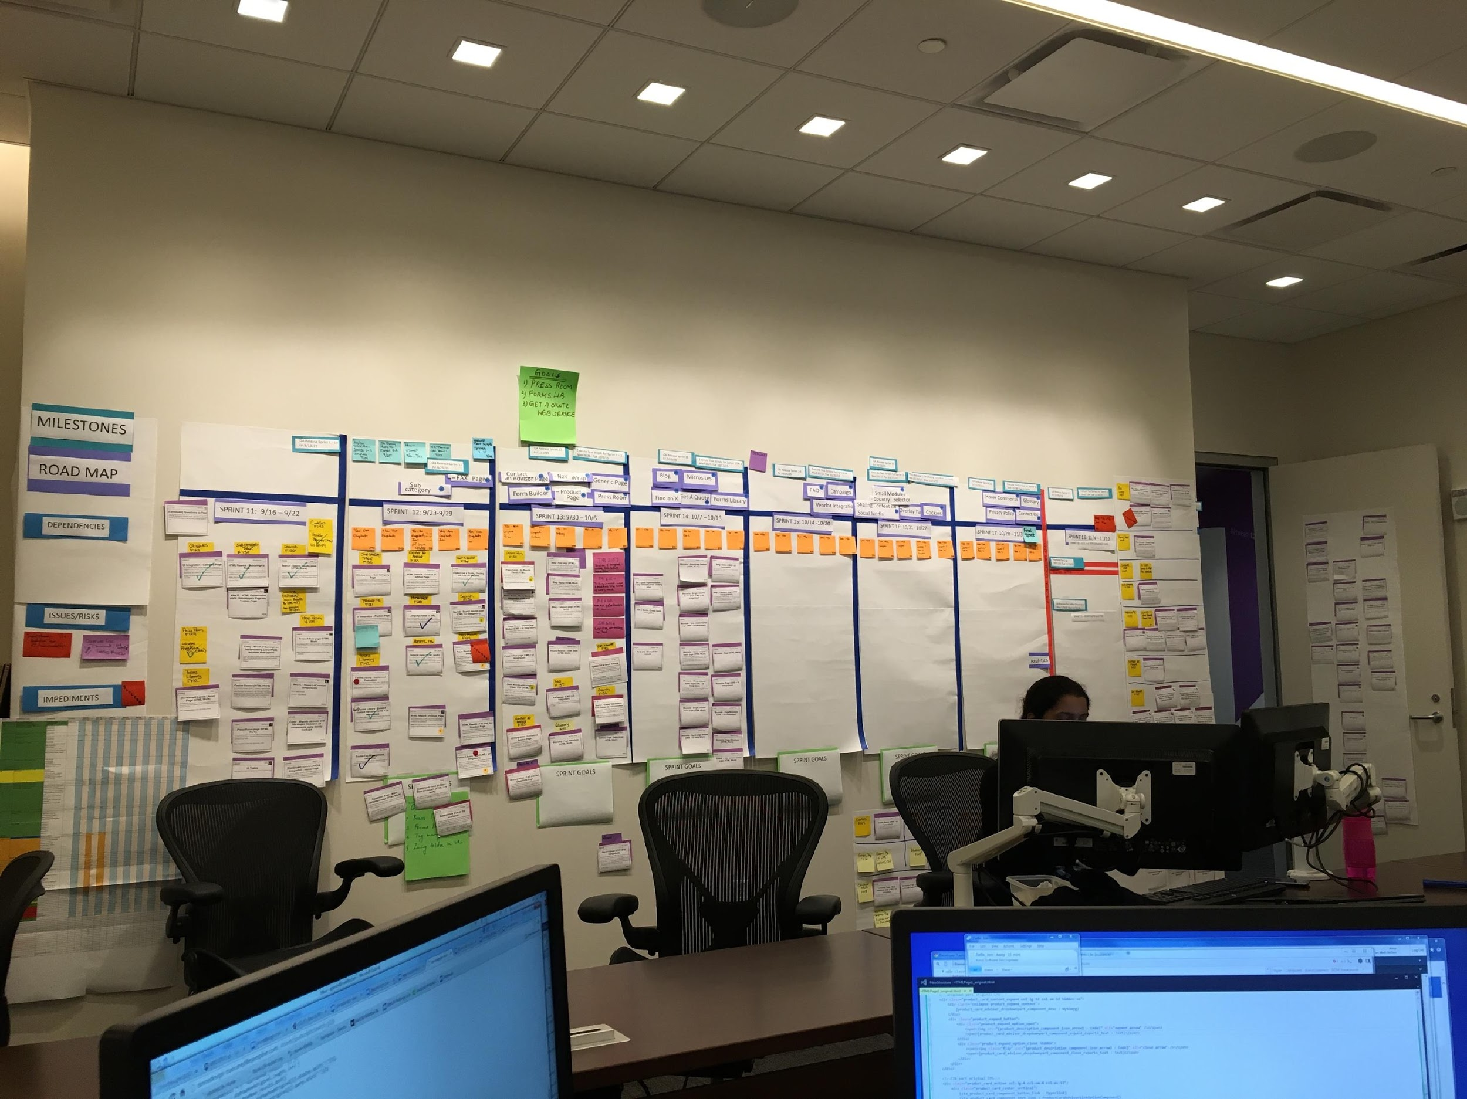
User Stories in Action

Slide 14
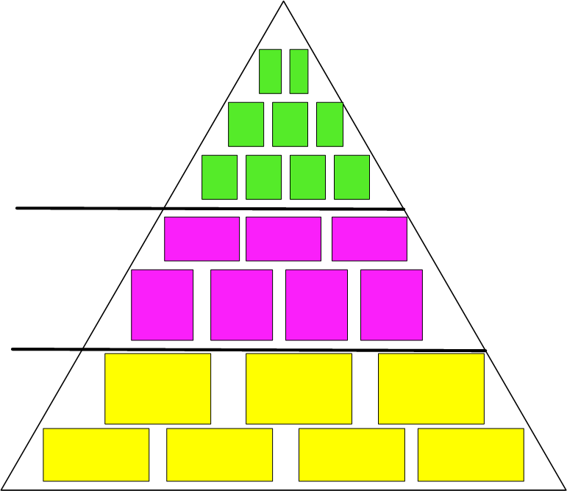
Agile Requirements Granularity
Sprint:
Stories = can be started and completed in one iteration
Theme:
collection of related user stories or epics
Release: epics or stories
Epic = larger requirement; grouping of stories
Product backlog
Project plan, everything
the team plans to
deliver/fix

Slide 15
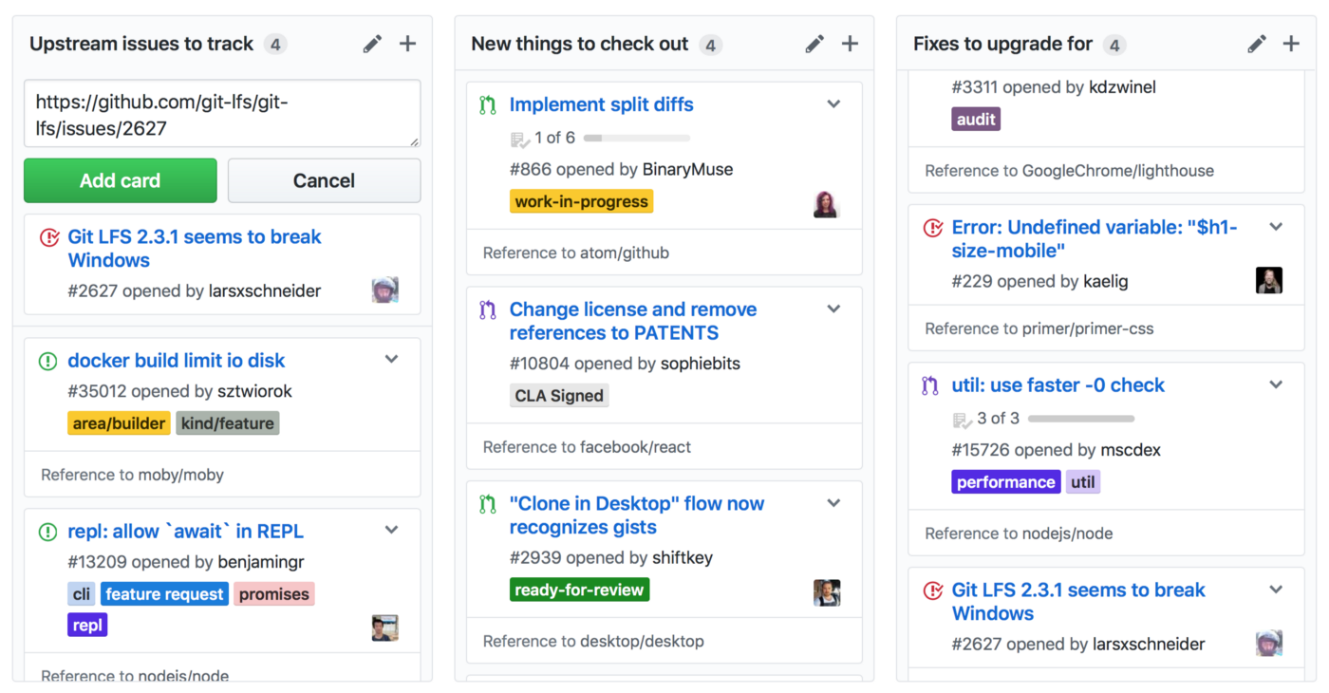
Project Board on Github
https://codeburst.io/an-introduction-to-github-project-boards-2944e6ffbf3c

Slide 16
Kanban Tools
GitHub Projects: https://github.com/features/project-management/
Trello
LeanKit
Visual Studio Team Services

Slide 17
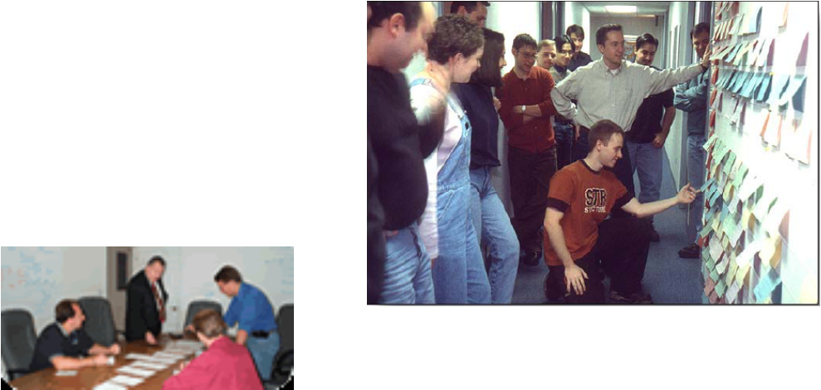
Weekly cycle
Review, reflect, plan, break into tasks
Highest priority stories in “time boxed” weekly increments
Provides “heartbeat” for project

Slide 18
Daily Scrum
Who attends?
Developers, testers, product owner, ScrumMaster/project manager, others as available: UI, doc, etc. … the “whole world”
Three questions and only three questions (and not the solutions):
What did you do since the last Scrum meeting?
What will you do before the next meeting?
Do you have any obstacles in the way of doing your work?
Provides coordination mechanism
Once per day, hear where everyone is
Remove obstacles
Self-empowered team steps up to help
May require management support
Each team mate provides verbal commitment to his/her peers (“accountability buddy”)

Slide 19
Best Practices for Using Git
Online document: Simple conventions which make Git work best for a team(https://deepsource.io/blog/git-best-practices/)
Make clean, single-purpose commits
Write meaningful commit messages
Commit early, commit often
Don’t alter published history
Don’t commit generated files
Youtube video: A Better Git Workflow with Rebase
https://www.youtube.com/watch?v=f1wnYdLEpgI

Slide 20
Conclusions
Agile was created as an improvement over waterfall software development
Agile consists of a number of different development methods, all bound together with the same values:
Individuals and interactions
Working software
Customer collaboration
Responding to change

